Slide 1
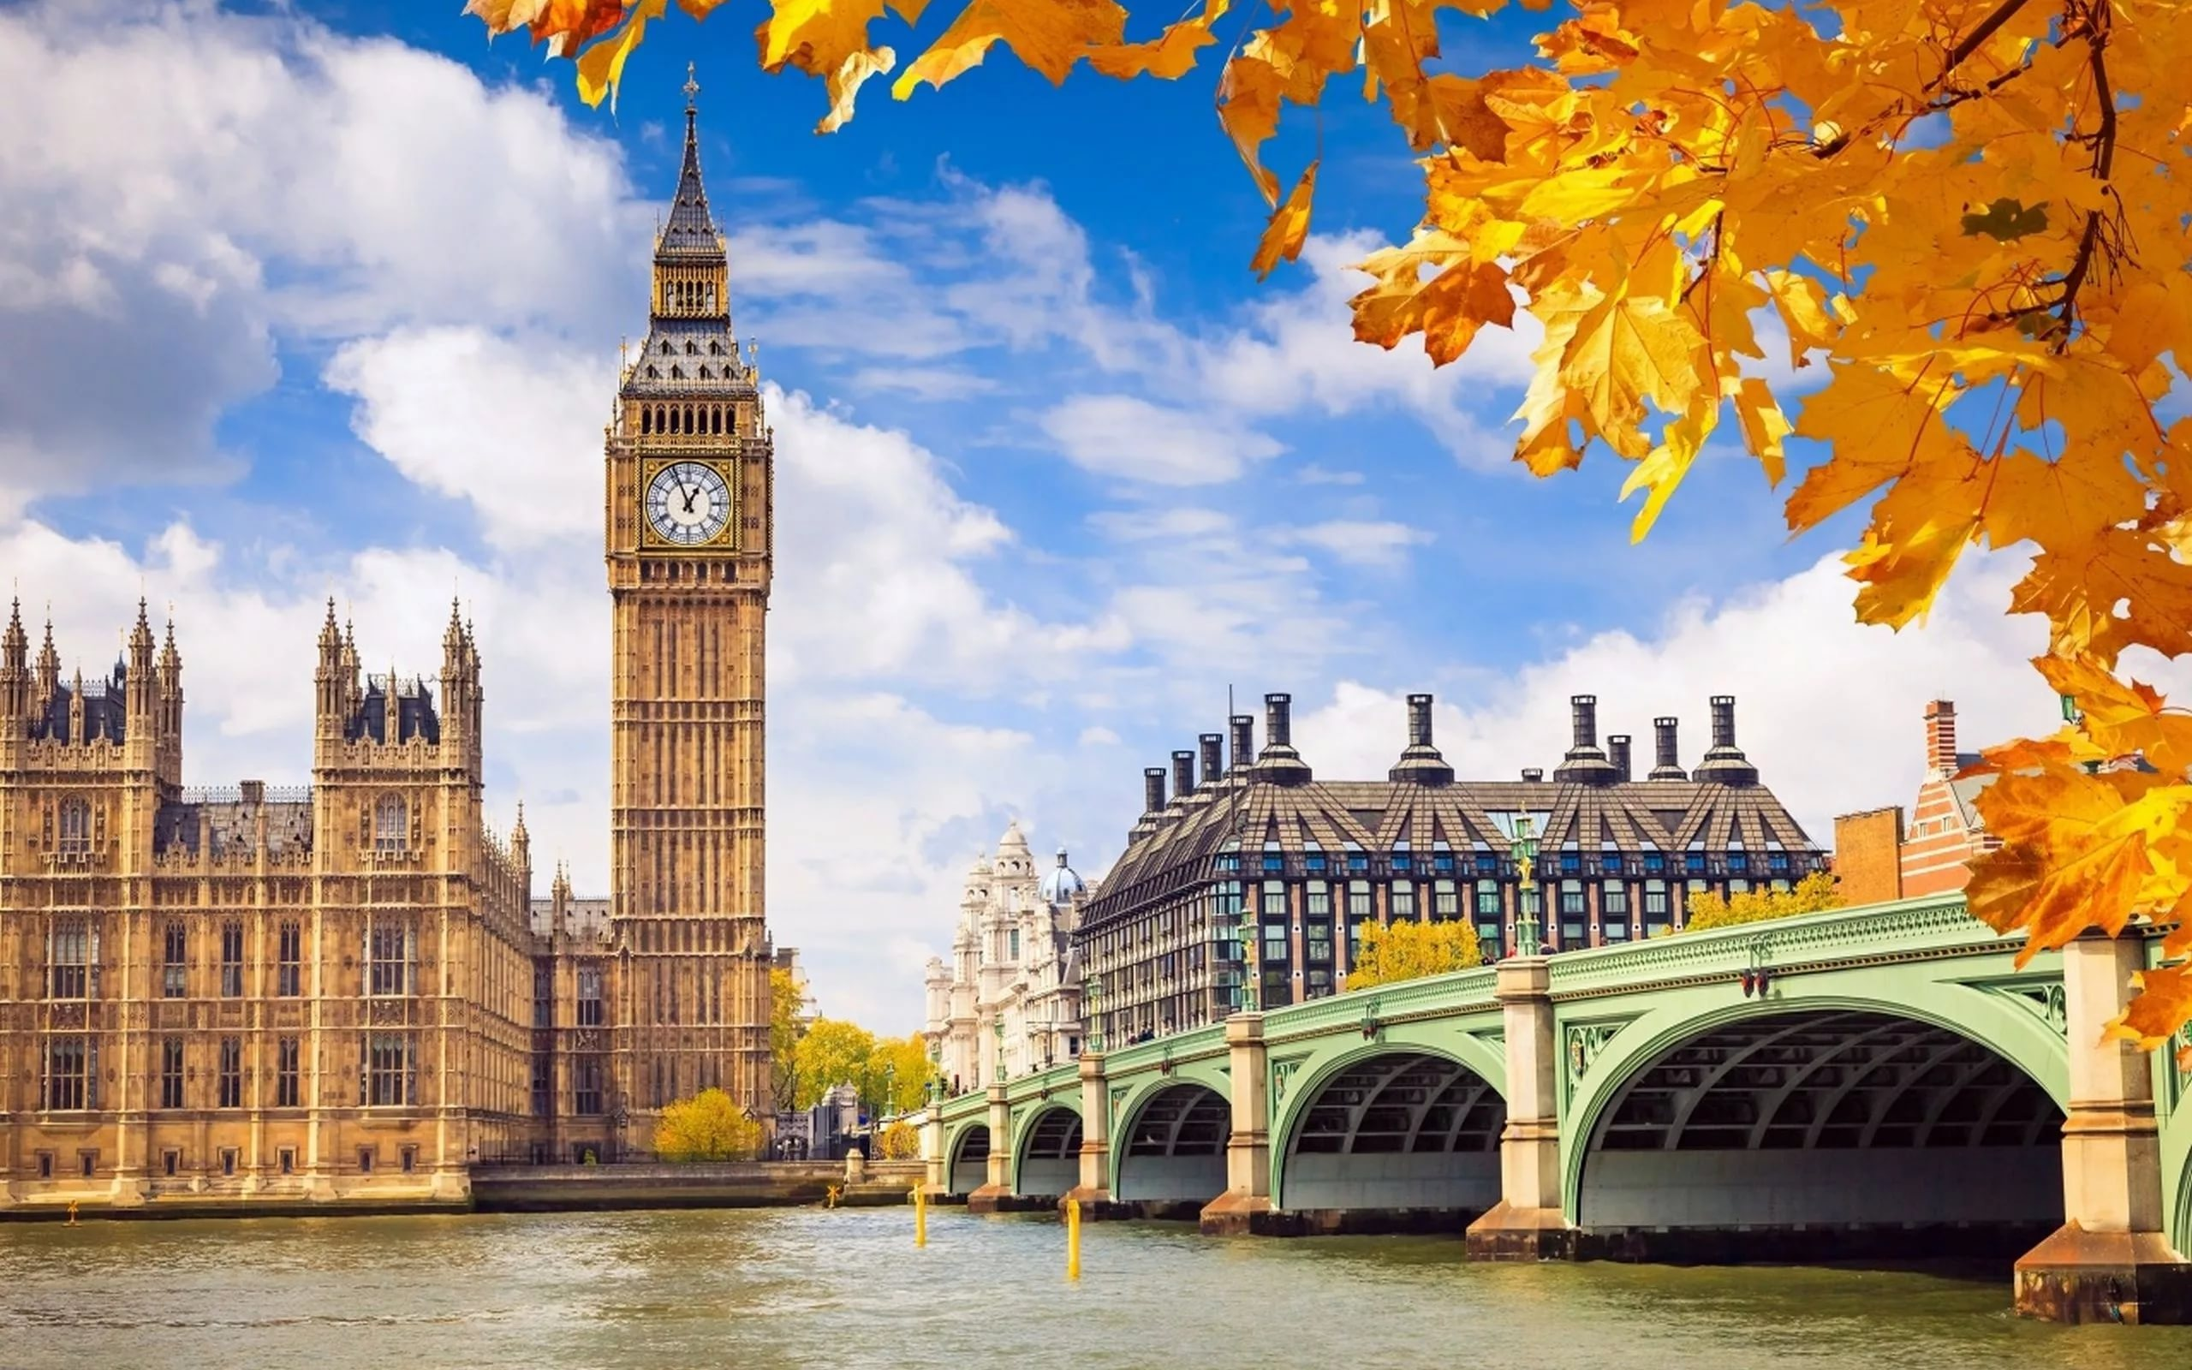
LONDON

Slide 2
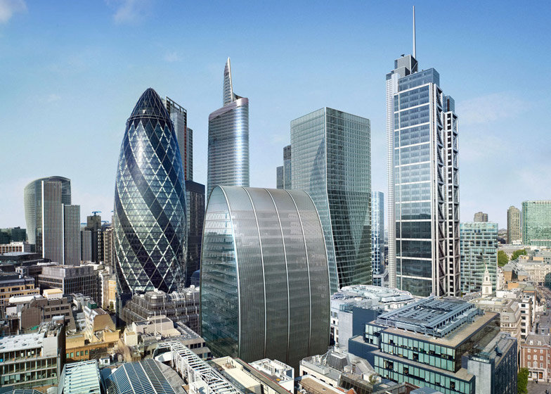
The city
The City of London is the historic heart of
London.

Slide 4
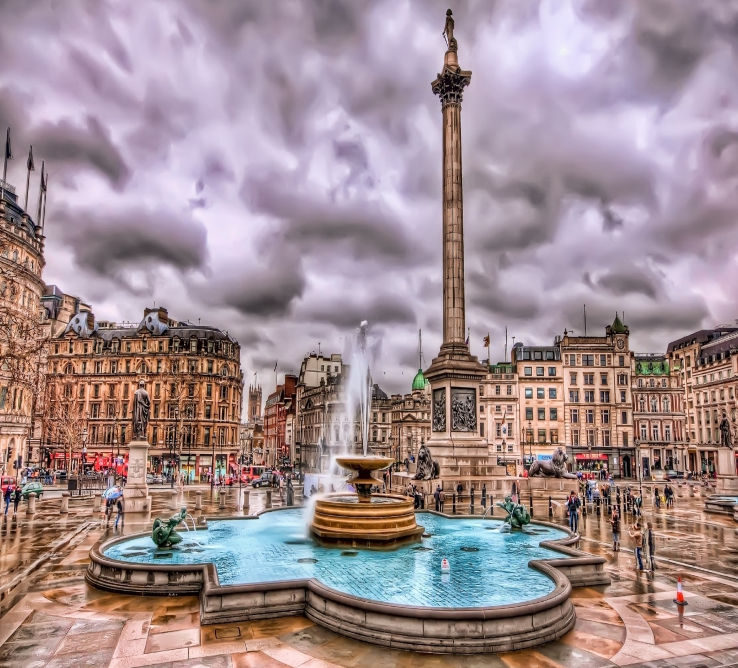
Trafalgar Square
It is the central square of London and traditional place for people to meet.
The statue of national hero Admiral Nelson stands there.

Slide 5
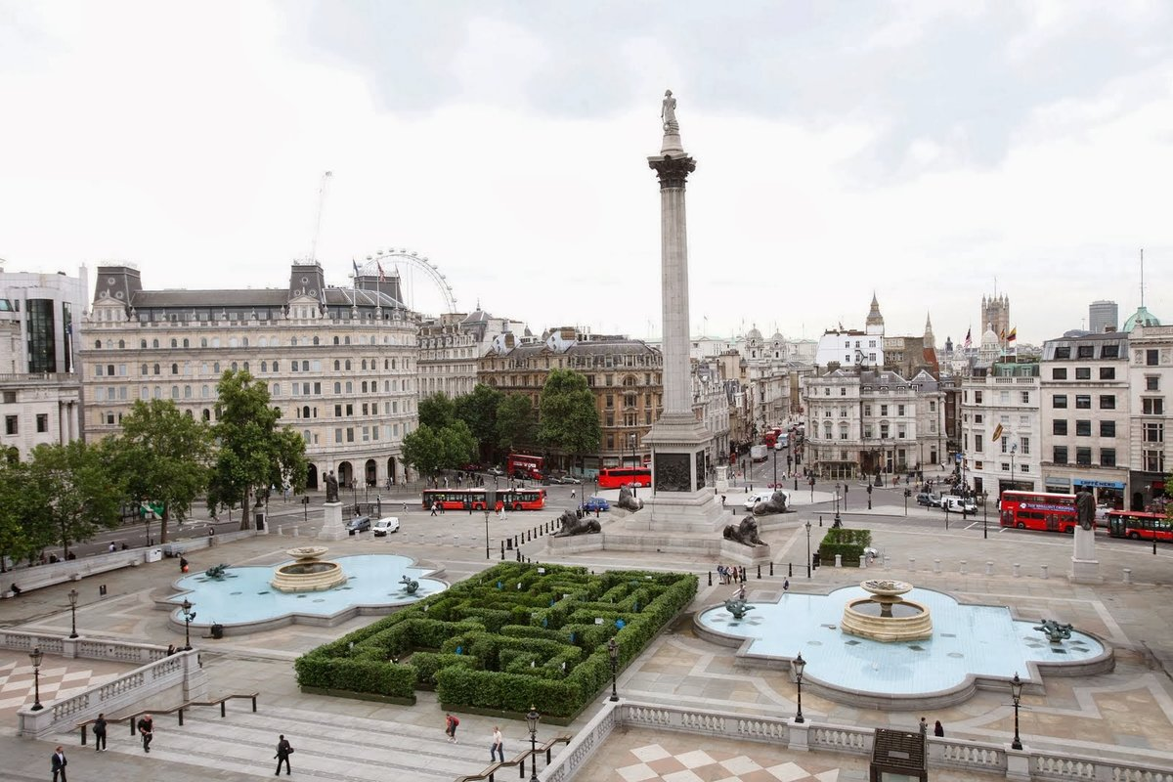
Nelson’s Column

Slide 6
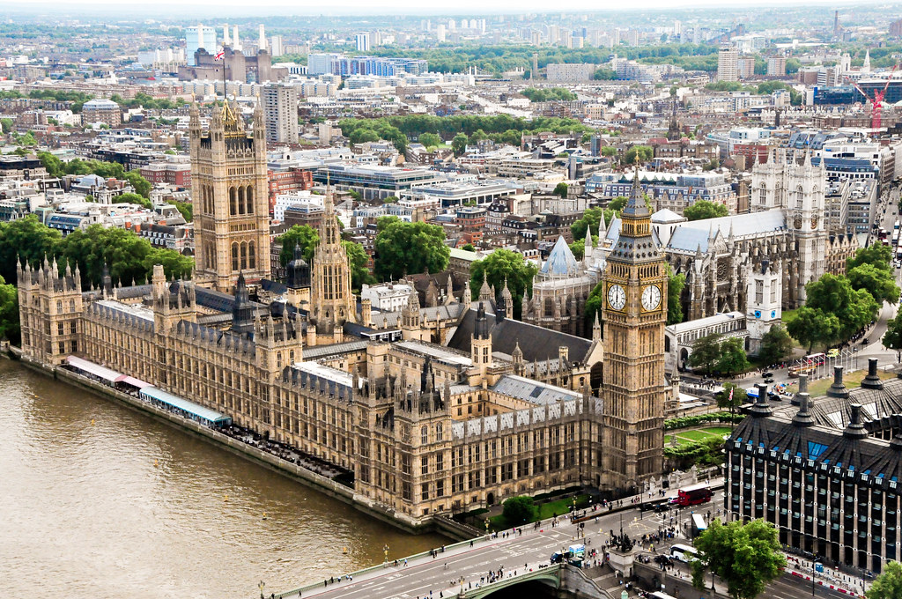
The Houses of Parliament
It is a place where the British Government sits.
It consists of three parts: the Royal Apartments, the House of Lords and the House of Commons.

Slide 10
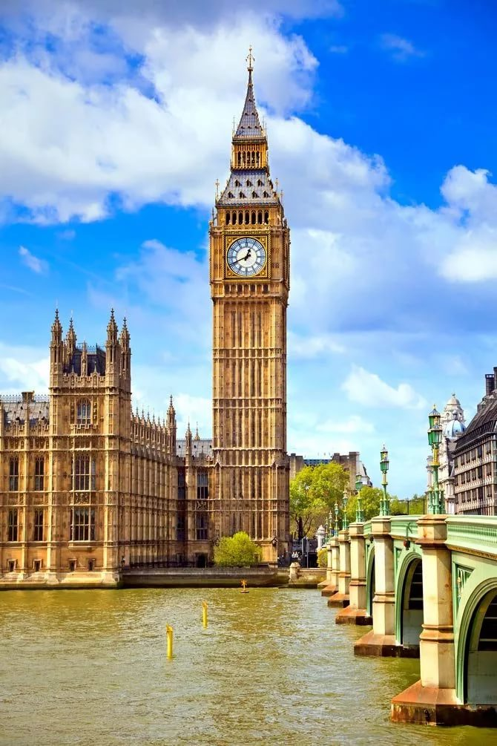
Big Ben
It’s a clock in the tower and it is a big bell.
You can hear it every hour.
People are allowed to get inside the Tower so that they can see the work of the clock.
There is no lift and there are three hundred and forty steps (340).

Slide 12
Tower Bridge
It is the oldest and famous bridge across the Thames.
Originally it was made of wood by the Romans, but it was often burnt down.
Later it was made of stone.
Finally it was rebuilt and made of concrete.

Slide 13
The Tower of London
It has a long history. In the past it was a fortress, a prison, a castle and a zoo.
It was built to protect the city from the enemies. There are a lot of ravens at this place.
There is a legend that without them the Tower will fall.
Nowadays this building is a very popular museum.

Slide 14
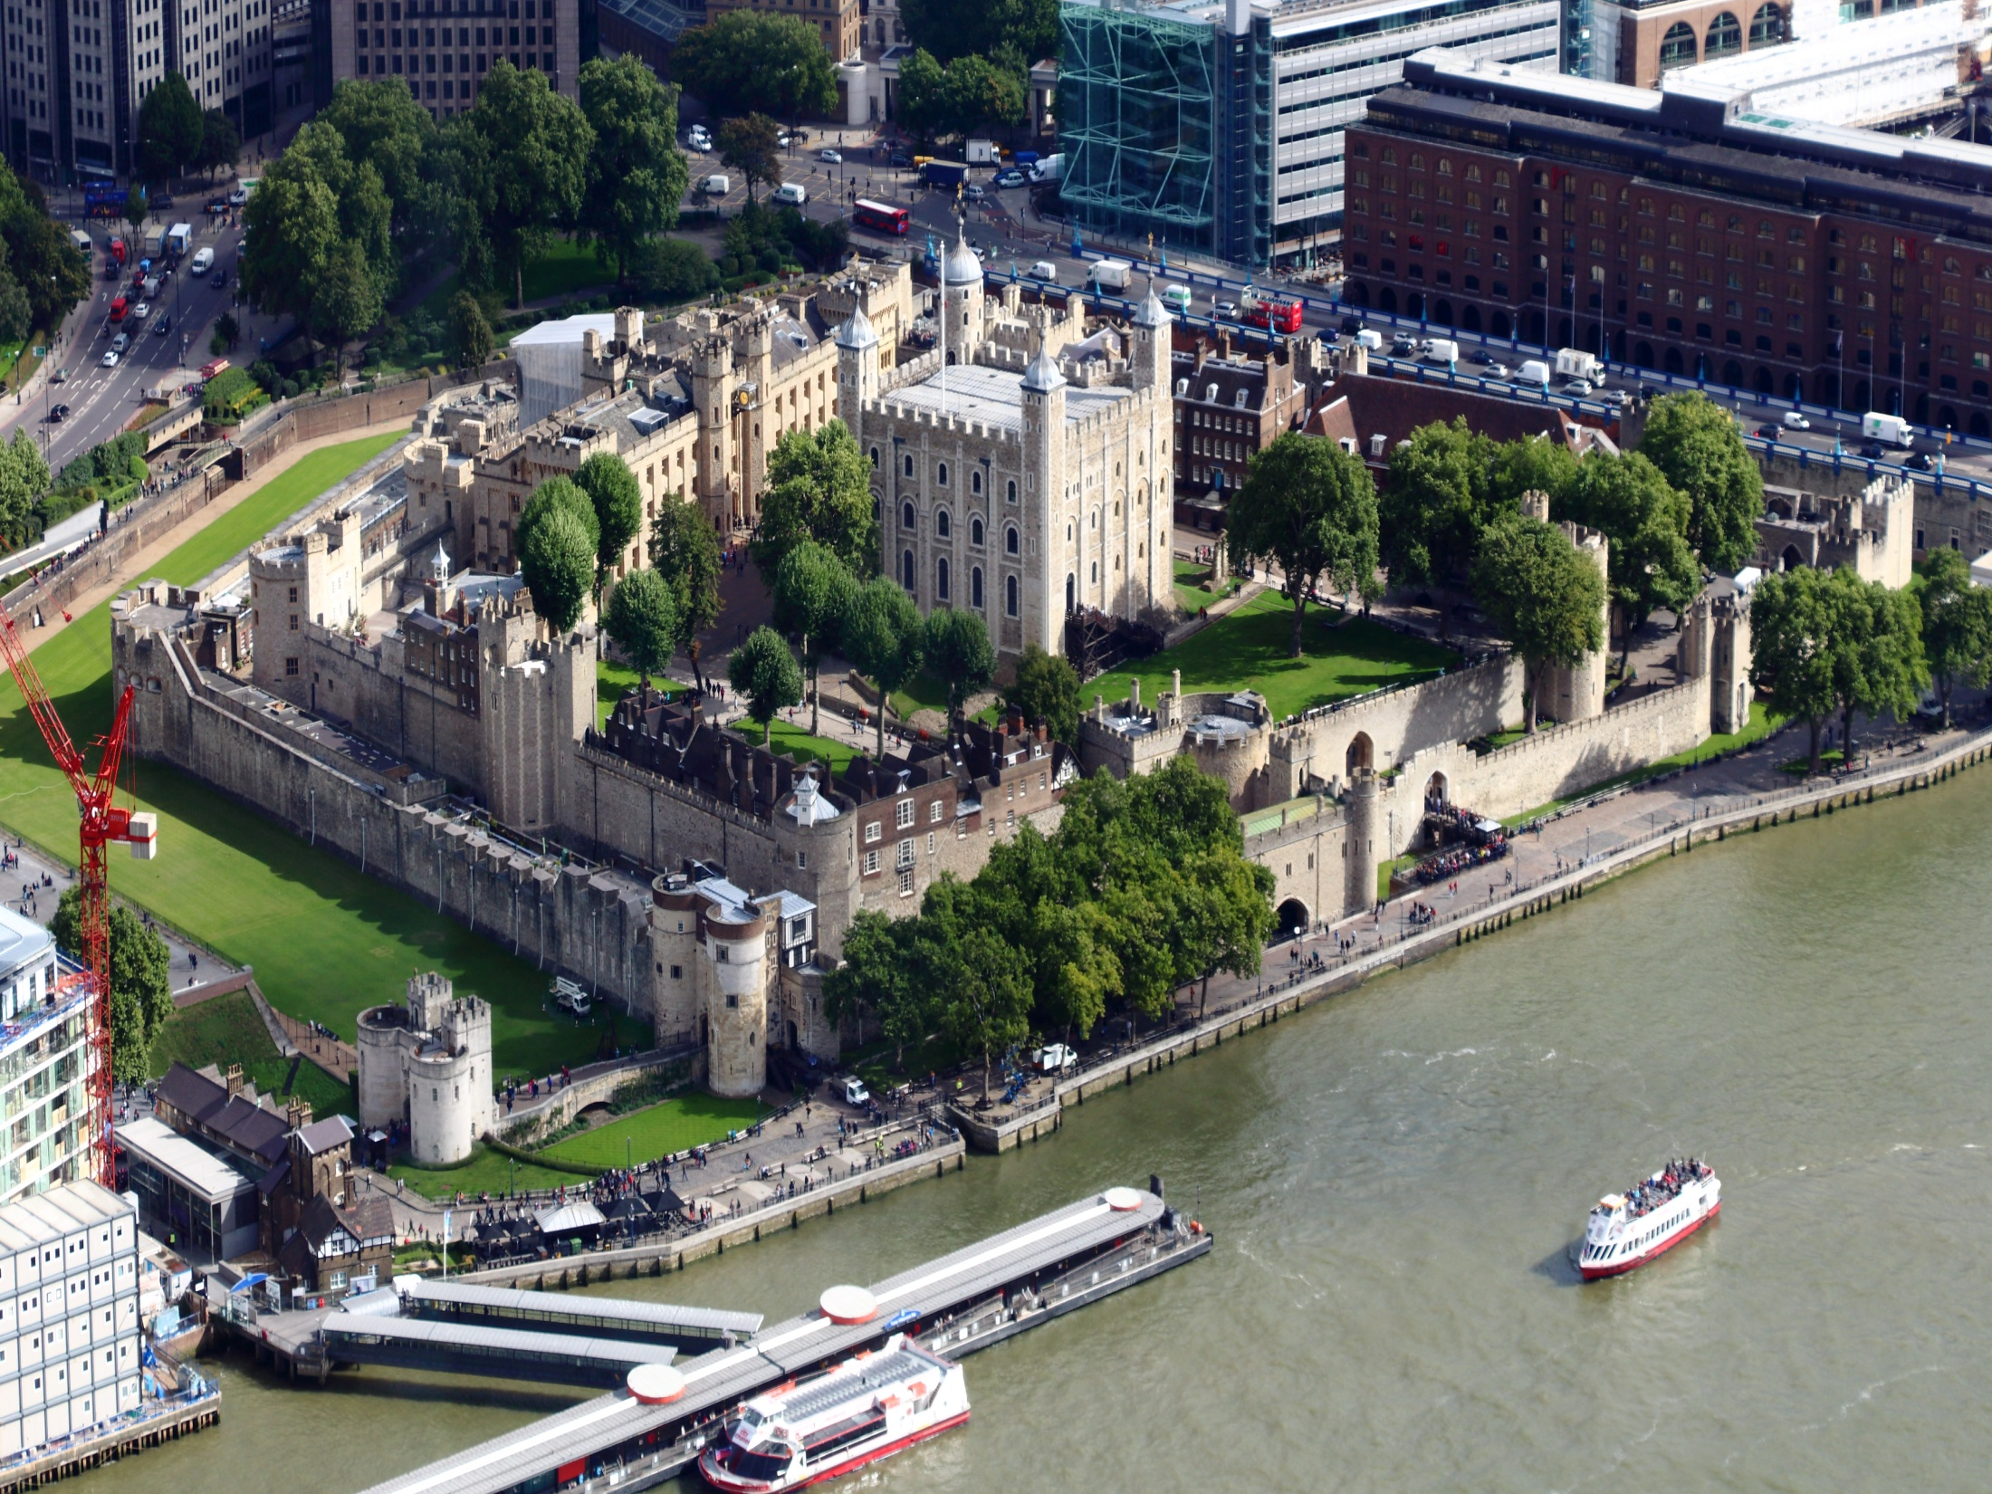

Slide 15
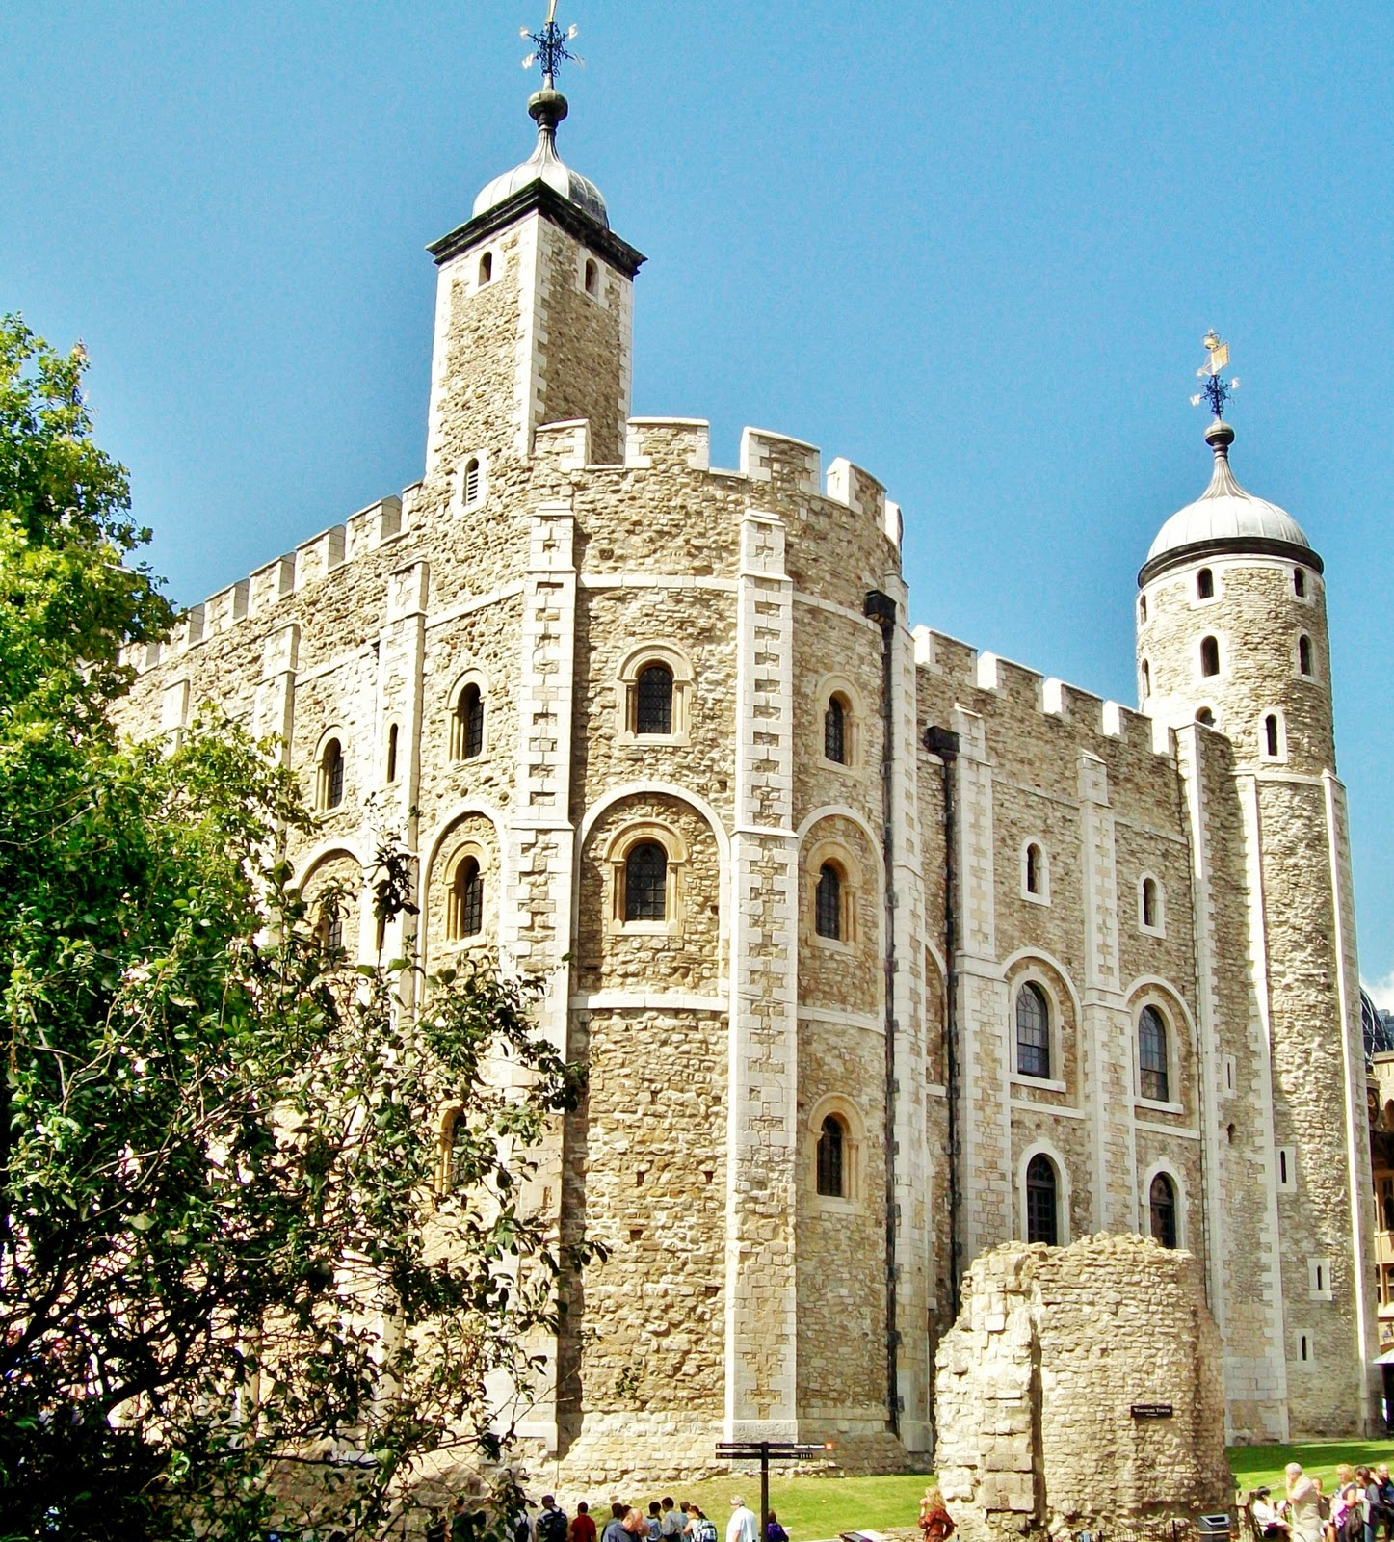
The White Tower
The White Tower is the oldest part of the Tower of London complex, it was built by William the Conqueror between 1078 - 1097.

Slide 23
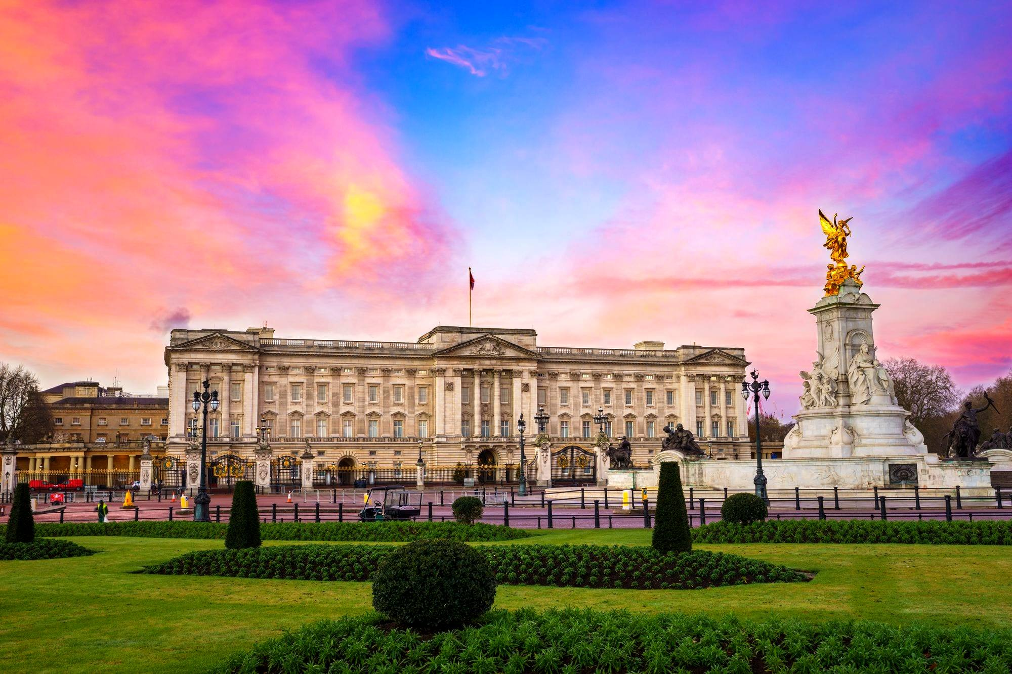
Buckingham Palace
It’s the London home of the Queen.
The palace is open to public.

Slide 26
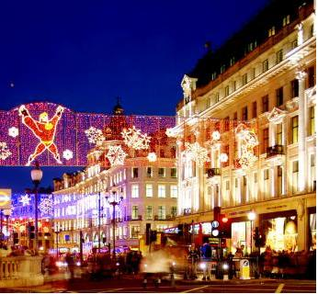
Oxford Street
It is the biggest shopping street in London.
There are 548 shops in Oxford Street.
Each Christmas the street is decorated with festive lights.

Slide 27
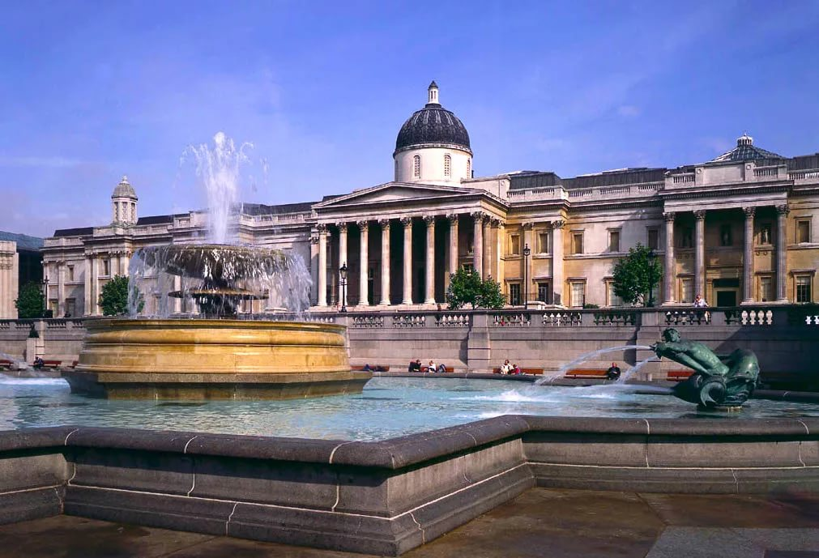
The National Gallery
The National
Gallery
is an art gallery in
London, which has one of the finest collections of European paintings in the world.

Slide 28
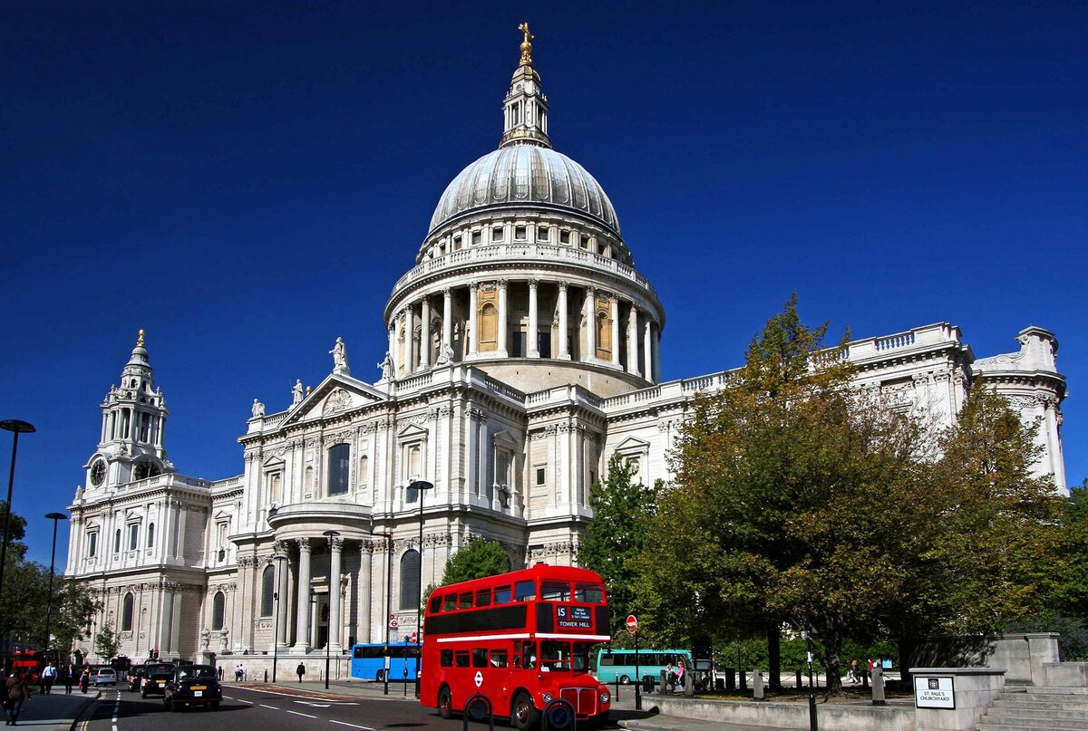
St Paul's Cathedral
St Paul's
Cathedral is an Anglican cathedral, the seat of the Bishop of London. It was designed by the Baroque style by Sir Christopher Wren

Slide 29
Choose the right variant:
1) The Tower of London is:
a) a prison
b) a museum
c) a shop
2) Big Ben is the name of:
a) the clock tower
b) the palace
c) the church
3) Which bridge is in London?
a) Brooklyn Bridge
b) Tower Bridge
c) Boston Bridge
4) The Queen lives in:
a) the Tower of London
b) the Houses of Parliament
c) Buckingham Palace

Slide 30
Choose the right variant:
5.You can see it from the river Thames. It is very old. It was a fortress, a prison, a palace and now it is a museum.
a)The Tower of London
b)Westminster Abbey
c)the Houses of Parliament

Slide 31
Choose the right variant:
6.It is a place where the British Government sits
a)The Tower of London
b)Buckingham Palace
c)Westminster Abbey

Slide 32
Choose the right variant:
7.It is the biggest church in London.
a)the Tower of London
b)St. Paul’s Cathedral
c)Westminster Abbey

Slide 33
True or false:
Buckingham Palace is the official residence of the Queen.
Big Ben is a beautiful London museum.
Parliament consists of two Houses.
Nelson’s column is situated on Trafalgar Square.
Changing the guard takes place near the Tower Bridge.
The Tower of London used to be a palace, a fortress and a prison.

